Slide 1
Bios 520-Clinical Trials
January 26, 2023

Slide 2
Outline
Grading/Graders update
Homework #1 review
Syllabus update
# Homeworks this semester
Survival bootcamp part I
Lecture on clinical design
‘Effects’ are not a separate topic but weaved in

Slide 4
Four Types of Clinical Trials
Phase I: Pharmacologically oriented—best dose of drug
Phase II: Preliminary evidence of efficacy & side effects
Phase III: New treatment is compared conclusive evidence
Phase IV: Post marketing surveillance

Slide 5
Phases of Clinical Trials (Cancer) [1]
Phase 0 - Preclinical
Preclinical animal studies
Looking for dose-response
Phase I
Seeking maximum tolerated dose (MTD)
Patients usually failed other alternatives
Phase II
Estimate of drug activity
Decide if drug warrants further testing (Phase III)
Estimate of serious toxicities

Slide 6
Phases of Clinical Trials (Cancer) [2]
Phase III
Provide effectiveness of drug or therapy
Various designs
No control
Historical control
Concurrent
Randomized
Testing for treatment effect
Phase IV
Long term post Phase III follow-up
Concern for safety

Slide 7
Design
The choice of design depends on the goal of the trial
Choice also depends on the population, knowledge of the intervention
Proper design is critical, analysis cannot rescue improper design

Slide 8
Phase I
First application of new treatment to generate prelim info on safety
Goal=find MTD with further testing of efficacy
Designed to find dose where 1/3 of patients experience dose limiting toxicity (DLT)
Standard escalation design tends to underestimate target dose
Ethical: first dose is on the low side and sequentially escalate if no toxicities are observed
Estimate MTD as 33rd percentile of dose-toxicity curve

Slide 9
Phase I
Phase I trials provide information about the MTD; it is important because most cancer treatments must be delivered at maximum dose for maximum effect.
Patients may die from toxicity or side effects and, if not treated “enough”, they might die from the disease too.
Phase I trials provide little or no information about efficacy; patients are diverse with regard to their cancer diagnosis and are treated at different doses - only 3 or 6 at a dose – even one at a dose by fast-track design
Notes:
early dose ranging trials
PK
intro of drugs in human.
characterisze pharm effect
Obj: MTD
not effiacacy although it will be assessed;not formally tested
absorption,distribution,metabolism,elimination,clearance and half life

Slide 10
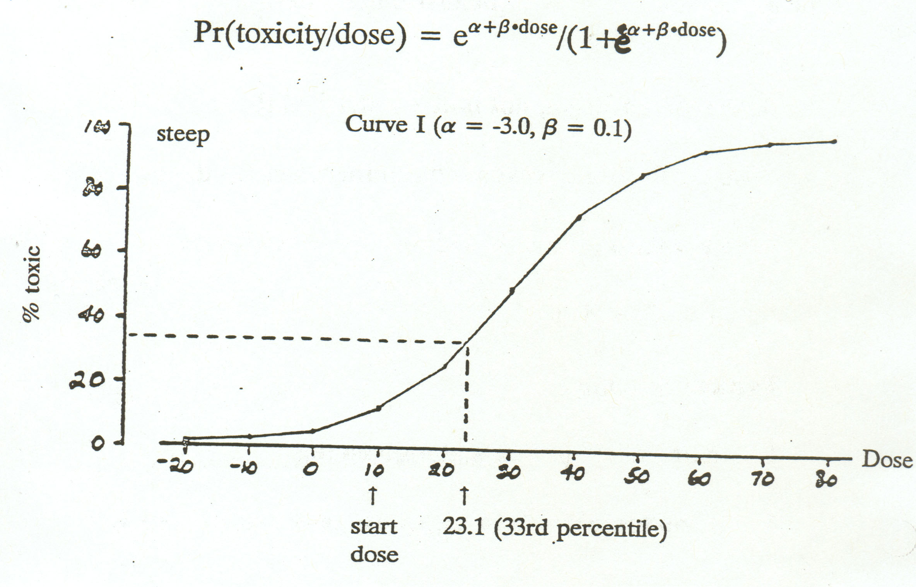
Dose-response curves
used in simulations

Slide 11
MTD
MTD is defined as the dose expected to produce some degree of medically unacceptable dose-limiting toxicity in a specified proportion θ of patients.
The value of θ could be set relatively high when the DLT is a transient, correctible, or nonfatal condition, and low when it is lethal or life-threatening.

Slide 12
Phase I Design
Typical/Standard Design
Based on tradition, not so much on statistical theory
Dose escalation to reach maximum tolerated dose (MTD)
Dose escalation often based on Fibonacci Series
1 2 3 5 8 13 . . . .

Slide 13
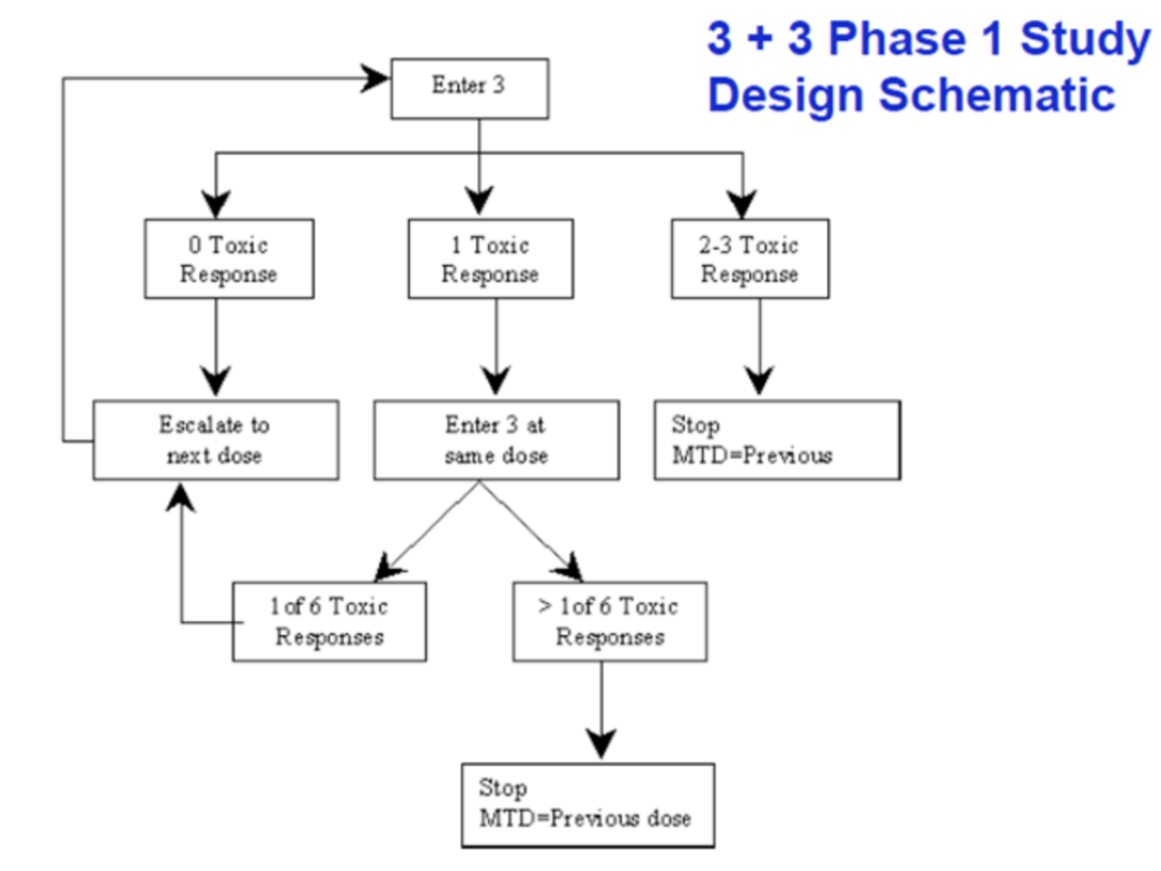
Typical phase I (3+3)
To limit the number of patients exposed to a potentially toxic or lethal dose of a new drug.

Slide 14
Typical Scheme
1. Enter 3 patients at a given dose
2. If no toxicity, go to next dosage and repeat step 1
3. a. If 1 patient has serious toxicity, add 3 more
patients at that dose (go to 4)
b. If 2/3 have serious toxicity, consider MTD
4. a. If 2 or more of 6 patients have toxicity, MTD reached (perhaps)
b. If 1 of 6 has toxicity, increase dose and go back to step 1

Slide 15
Summary of Designs Considered (1) (Storer, Biometrics 45:925-37, 1989)
A. “Standard”
Observe group of 3 patients
No toxicity→ increase dose
Any toxicity → observe 3 or more
One toxicity out of 6 → increase dose
Two or more toxicity → stop
B. “1 Up, 1 Down”
Observe single patients
No toxicity → increase dose
Toxicity → decrease dose

Slide 16
Summary of Designs Considered (2) (Storer, Biometrics 45:925-37, 1989)
C. “2 Up, 1 Down”
Observe single patients
No toxicity in two consecutive → increase dose
Toxicity → decrease dose
D. “Extended Standard”
Observe groups of 3 patients
No toxicity → increase dose
One toxicity → dose unchanged
Two or three toxicity → decrease dose

Slide 17
Summary of Designs Considered (3) (Storer, Biometrics 45:925-37, 1989)
E. “2 Up, 2 Down”
Observe groups of 2 patients
No toxicity → increase dose
One toxicity → dose unchanged
Both toxicity → decrease dose
B, C, D, E - fixed sample sizes ranging from 12 to 36 patients
Can speed up process to get to target dose range

Slide 18
Delays in Phase I studies
If none of these three participants experience a DLT, a subsequent three participants are enrolled onto the next highest dose level. If one of three participants at a dose level experiences a DLT, up to three more participants are enrolled. When a DLT is observed in at least two participants in a cohort of three to six, the MTD is exceeded and an additional three participants (up to a total of six) are treated at the next lower dose level. The MTD is defined as the dose level at which none or one of six participants (0% to 17%) experience a DLT, when at least two of three to six participants (33% to 67%) experience a DLT at the next highest dose.
In the 3 + 3 design, accrual is suspended after enrollment of each cohort of three patients. When a participant becomes unevaluable for toxicity, most commonly because of early disease progression, the cohort is reopened to a single patient.

Slide 19
Motivation for rolling 6
One of the primary reasons for the original development of the 3 + 3 design was to limit the number of patients exposed to a potentially toxic or lethal dose of a new drug.
Low mortality rate (<1%)
Protocol suspension can be long
Most doses expand to 6 patient
The rolling six design allows for accrual of two to six patients concurrently onto a dose level

Slide 20
Rolling Six
Mostly a pediatric design
Intention to reduce the time to ‘wait’ between enrollment and toxicities observed
Premise: enroll between two and six patients at a dose level without requiring that the dose-limiting toxicity (DLT) status of the patients already assigned to the same dose level are known.

Slide 21
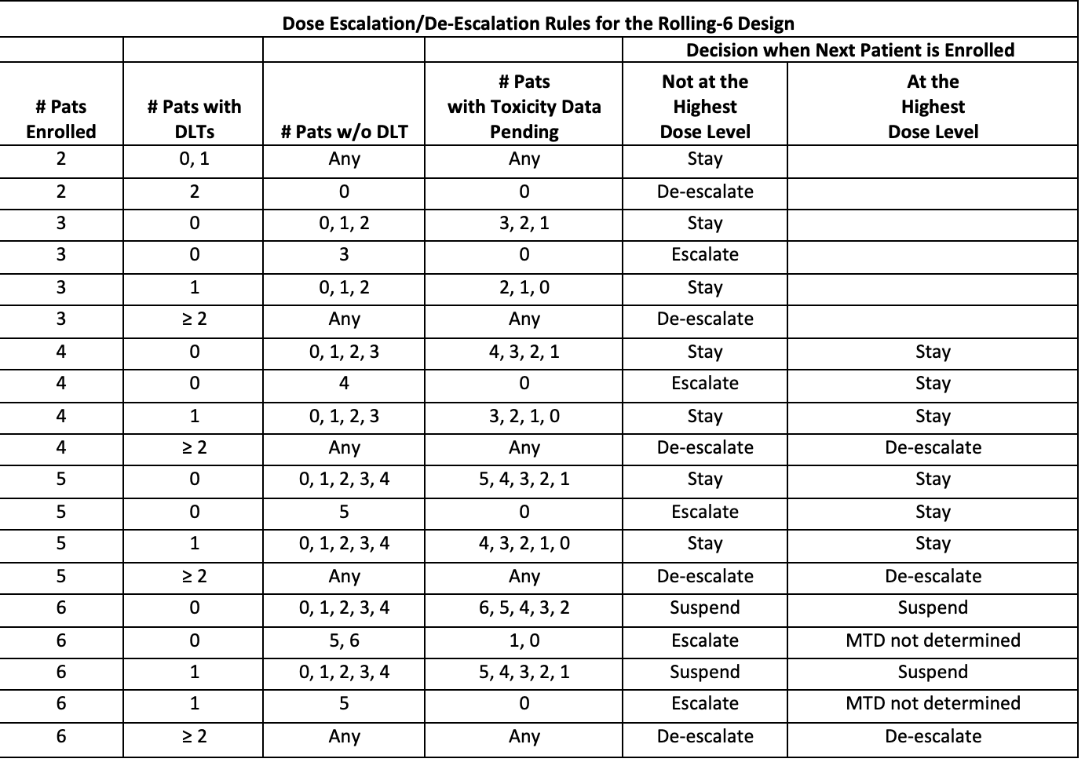
Typical rolling 6 design

Slide 22
Bayesian Optimal Interval Design (BOIN)
Find the maximum tolerated dose and to minimize the probability of inappropriate dose assignments for patients.
BOIN seeks a dose with probability of toxicity close to some pre-specified target level
The entire range of possible values can be broken 3 intervals:
The underdosing interval (UI)
The equivalence interval (EI)
The overdosing interval (OI)

Slide 23
High level view
The conduct of a phase I trial can be viewed as a sequence of decision-making steps of dose assignment for patients who are sequentially enrolled in the trial.
Three actions: escalate, de-escalate or retain the current dose.
Assumption that efficacy monotonically increases with toxicity, an ideal trial design would escalate the dose when the current dose is below the MTD to avoid treating a patient at subtherapeutic dose levels, de-escalate the dose when the current dose is above the MTD to avoid exposing a patient to overly toxic doses and retain the same dose level when the current dose is equal (or close) to the MTD.

Slide 24
High level part II
However, such an ideal design is not available in practice because we do not know whether the current dose is below, above or equal (or close) to the MTD, and we need to infer that information and to make decisions based on the data collected from patients who have been enrolled in the trial.
Given the randomness of the observed data and small sample sizes of phase I trials, the decisions of dose assignment that we make are often incorrect; for example we may escalate (or de-escalate) the dose when it is higher (or lower) than the MTD, which results in overly aggressive (or conservative) dose escalation and treating excessive numbers of patients at dose levels above (or below) the MTD.
From a practical and ethical viewpoint, it is highly desirable to minimize such decision errors so that the actual design behaves as closely as possible to the ideal (error-free) design.

Slide 25
Example from a SCD study
The Bayesian Optimal Interval (BOIN) design based on the cumulative number of patients who experience serious toxicities, infection, GVHD and other transplant related mortality
Assumptions for an example: 1) the target true toxicity rate is 0.20; 2) a true toxicity rate of 0.6 times the target rate or lower is deemed sub-therapeutic such that dose escalation is required; 3) a true toxicity rate of 1.4 times the target rate or higher is deemed overly toxic such that a de-escalation is required; 4) non-informative prior.
Based on these parameters, the derived BOIN escalation and de-escalation boundaries for the observed toxicity rate are 0.157 and 0.238, respectively.
IF observed toxicity rate at the current dose level is ≤ 0.157, then the dose is escalated for the next cohort.
IF the observed toxicity rate is ≥ 0.238, then the dose is de-escalated for the next cohort of subjects.
If the posterior probability that the DLT is above the maximum tolerated dose (MTD) is > 0.95 at the current dose, then the current dose level and higher doses will be eliminated.
The trial will be terminated if the lowest dose is eliminated. The number of patients treated at each dose will not exceed 9 in the dose escalation portion of this trial.

Slide 26
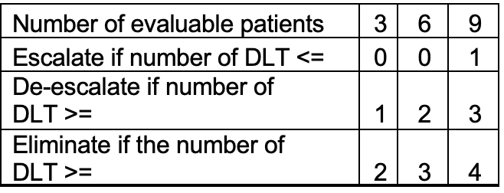
Example

Slide 27
Phase I summary
25% of the oncology agents registered by the FDA are labeled at a dose different from that identified in phase I trials
Six patients are clearly insufficient to provide an accurate estimate and the statistical community agrees on the limitations of the 3 + 3 method
Mechanisms of action of targeted agents strongly challenge the hypothesis that the MTD systematically constitutes the optimal dose, which is the basis of the 3 + 3 design.

Slide 28
Phase II
It is desirable to find out about the anti-tumor capacity of new agents and to determine if a treatment is sufficiently promising to warrant a major controlled evaluation. However, recall that there are three basic objectives in conducting phase II clinical trials:
Benefit the patients
Screen agent/drug for anti-tumor activity
Extend knowledge of toxicology and pharmacology of drug/agent.

Slide 29
The challenge of Phase II studies
The problem is that, if the agent has no or low anti-tumor activity, patients in the phase II trial might die from the disease. Therefore, we often wish to minimize the number of patients treated with an ineffective drug.
Early acceptance of an highly effective drug is permitted but very rare in phase II trials; however, it is ethically imperative to exercise early termination when the drug has no or low anti-tumor activity.

Slide 30
Phase II Design Goals
Goal for any phase II study
Screen for therapeutic activity
Further evaluate toxicity
Test using MTD from Phase I
If drug passes screen, test further

Slide 31
Two stage design
The trial is conducted in two stages with the option to stop the trial after the first or after the second stage (and not recommending the agent for further development).
The basic approach is to “minimize” expected sample size when the true response is low - say, less than some pre-determined uninterested level.

Slide 32
Two stage phase II design
Cancer research uses a two stage design
If not enough responses are seen in first stage, stop study.
If not enough responses after 2nd study, conclude the study is not efficacious

Slide 33
Simon optimization
Expected ‘n’ is minimized if treatment has low activity
Maximum ‘n’ is not minimized
H₀: p=p0 (10%)……….p≤ p₀
H_{a}: p>p0 (10%) ….p≥ p₁
Simon R. (1989) “Optimal Two-Stage Designs for Phase II Clinical Trials” Controlled Clin Trials 10:1-10.

Slide 34
Properties of Simon procedure
If H₀ true, probability of promising drug < α
If H_{a} true, probability of rejecting drug < β
Specify α, β, p₀, p₁

Slide 35
Example
Let’s say that the disease you are studying will have a ‘bad’ response rate of .4 and a ‘good’ rate of .6
There can be many different possible designs (next slide)
The number of responses given in the design indicate the cutoff for termination. To continue study you need MORE responses

Slide 36
How does this work?
P0=.4 p1=.6
R1 | N1 | R | N | PET
7 | 18 | 22 | 46 | .56
7 | 16 | 23 | 46 | .72
11 | 25 | 32 | 66 | .73
α=.1 β=.1
α =.05 β=.2
α =.05 β=.1

Slide 37
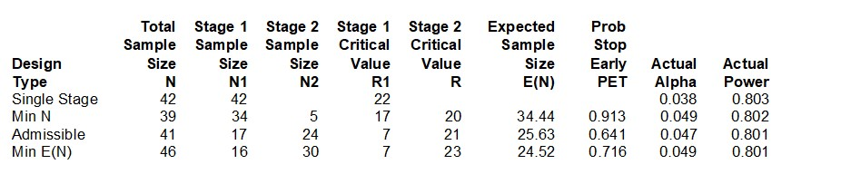
Computer output for 80% power

Slide 38
Two stage design in H&N Cancer
Phase II study of Trimetrexate in adv. H&N cancer
Accrue 17 patients in stage I
Terminate if < 4 responses

Slide 39
H&N Study cont’d
With ≥ 4 responses, accrue 20 more patients
If ≤ 10 responses observed from 37 patients, reject drug

Slide 40
The design summary
Enroll n1 patients in stage 1; the trial is stopped if r1 or fewer responses are observed, goes on to the second stage otherwise.
Enroll n2 patients in stage 2; the trial is not recommended for further development if a total of r (of course: r > r1) or fewer responses are observed in both stages.

Slide 41
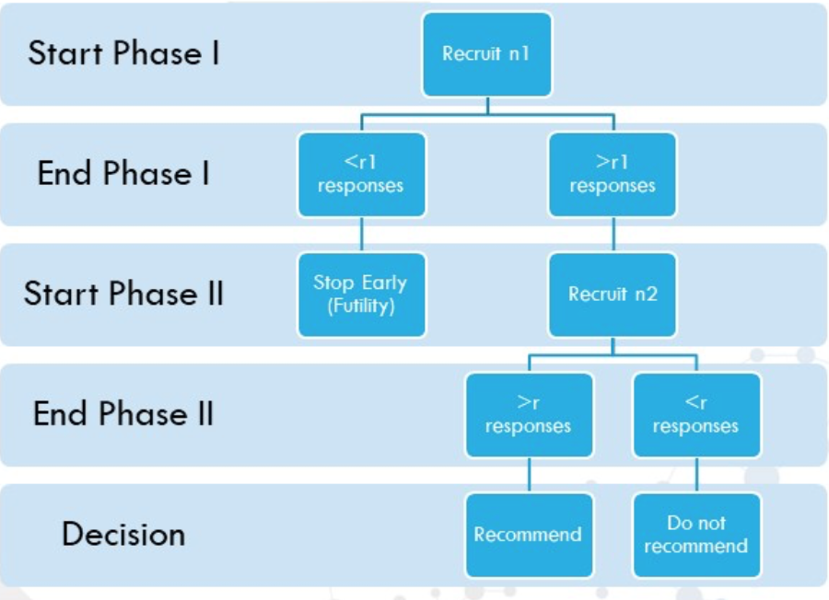
Stop for ‘early futility’
We will be returning to this concept for large Phase III studies

Slide 42
Operating Characteristics of E1390
Response rate
.2
.25
.3
.35
.4
.55 | .35 | .20 | .10 | .05
.36 | .36 | .26 | .13 | .05
.91 | .71 | .46 | .23 | .1
26 | 30 | 33 | 35 | 36
Pr (early stopping)
Pr (reject drug in stage II)
Overall probability of rejection
Expected ‘n’

Slide 43
Lung Cancer Example
Phase II study of ICE-T in advanced NSCLC
Stage IIIb and IV patients accrued equally
Two stage design based on toxicity

Slide 44
Rationale for different design
ICE and Taxol have shown efficacy in this disease site
This regimen has shown to be quite toxic also
Define stopping rule based on toxicity without stage distinction

Slide 45
Lung Cancer design
Accrue 20 patients in stage I
If ≥ 6 grade 3 (non-heme) or higher toxicities then stop early
If not, continue to total of 60

Slide 46
Characteristics of design
Given true severe or greater toxicity rate is 40% (i.e. unacceptable) , pr(early stopping)=.87
If true rate is low (i.e. 15%), pr(early stopping)=.067

Slide 47
How do you select the design?
Variety of computer output
No right/wrong answer
Consider operating characteristics of each design

Slide 48
How to choose the right design?
Error involved
Let inactive drug through
Reject active drug
Implications for your disease site?

Slide 49
Design selection
Not just about specification of parameters
Response evaluation in this patient population
Accrual expectations

Slide 50
What is optimal?
Want to stop early with low activity
May not be able to determine the ‘best’ design

Slide 51
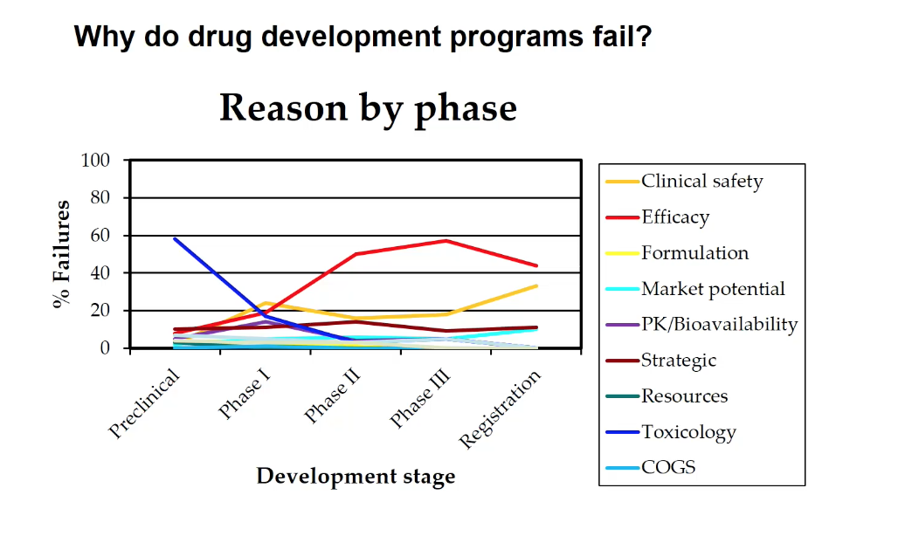
What is at stake for a bad design?

Slide 52
Let’s try this ourselves
http://cancer.unc.edu/biostatistics/program/ivanova/SimonsTwoStageDesign.aspx
Can you do this by hand?
Let’s try using alpha=.05, power=.8, bad=.1 and good=.3

Slide 53
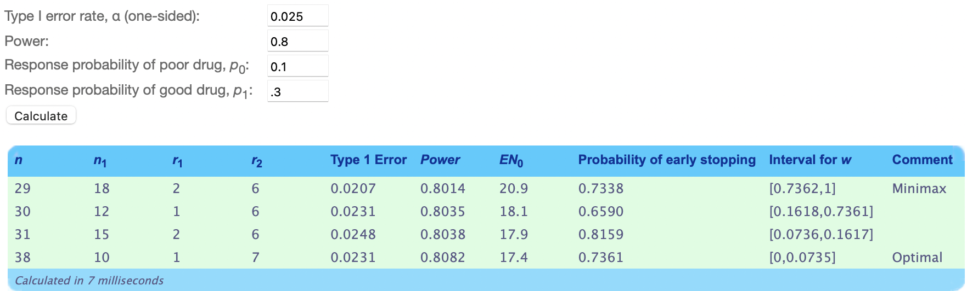
Output.. how is this calculated?
How do you describe what this means based on the context of each of these 4 designs?
If Type I error is Probability of rejecting H0 incorrectly
Power is the probability of rejecting H0 correctly

Slide 54
Output
Optimal is usually recommended because it has highest power
Minimax has larger first phase and higher E(N)
How is E(N) calculated
E(N)=N1+(1-PET)(N-N1)
PET=probability of early termination

Slide 55
Alterations
Randomize two treatment arms
Two two-stage design by patient group
Use measurement other than response

Slide 56
Problem with the design
The main practical consideration is that evaluation of a patient’s response is usually not instantaneous and may require observations for weeks or months.
Accrual at the end of stage 1 may have to be suspended until it is determined whether the criterion for continuing is satisfied.
Suspension is awkward for physicians who are contributing patients to the study; and is the main reason for not considering more than two stages.

Slide 57
Design pitfalls
Early acceptance of treatment not allowed
Response evaluation can take months
Drug often expected to be part of a combination so 25% response may be unrealistic

Slide 58
Summary
Phase II studies are necessary to get better estimation of efficacy
The goal is not to make definitive conclusions
Early stopping rules improve efficiency with scarce resources

Slide 59
Phase II Trials
Many – most cancer Phase II trials follow this design
Many other diseases could – there seems to be no standard non-cancer Phase II design
Might also randomize patients into multiple arms each with a different dose – can then get a dose response curve

